Slide 1
Bank Management System
Group Name :- Future Developers
Pratik Mahandule
Rushikesh Shinde
Ganesh Shirke
Arun Rajegore
Akshay Wankhede
Mujjakir Bagwan

Slide 2
Index
01
Overview of Project
05
ER Diagram
01
02
Project Portfolio
CONCLUSIONS
02
06
04
03
Description
03
04
Flow Chart

Slide 3

Overview of Project
We Created a console base bank management system Application Using java and Hibernate..
Its used to provide banking basic operations for customer and bank agent.
Customer can create Account, deposit/withdraw money, etc.
Bank agent can maintain account of user.

Slide 4
Project Portfolio
Bank User
Create new User
Login
Create New Account.
Name
Address
Phone Number
PAN ID
Fund Trasnfer
Deposit
Withdrawal
View Previous Transaction
View Balance

Slide 5
Description
The bank management system is an application for maintaining a customer’s account in a bank.
It is used to keep the records of clients, employees, and others in the bank.
The system allows customers to create accounts, deposit/withdraw money from their accounts, and examine reports for all of their accounts.

Slide 6
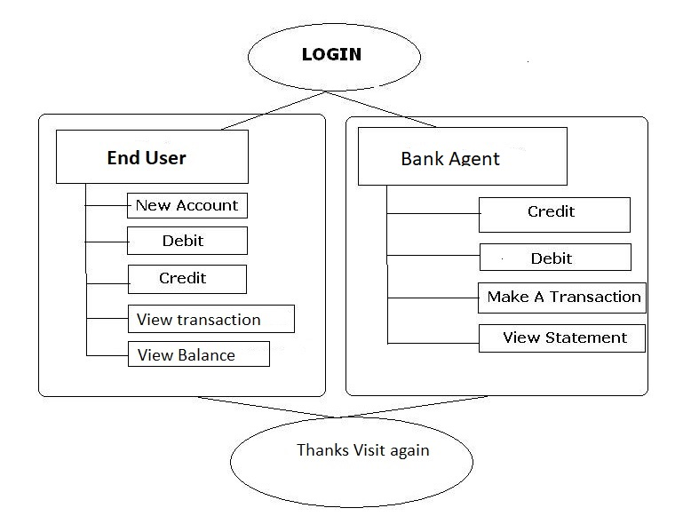





Flow Chart
How bank management system works, Let’s see how the flow of application which is explained through the below flow chart.

Slide 7
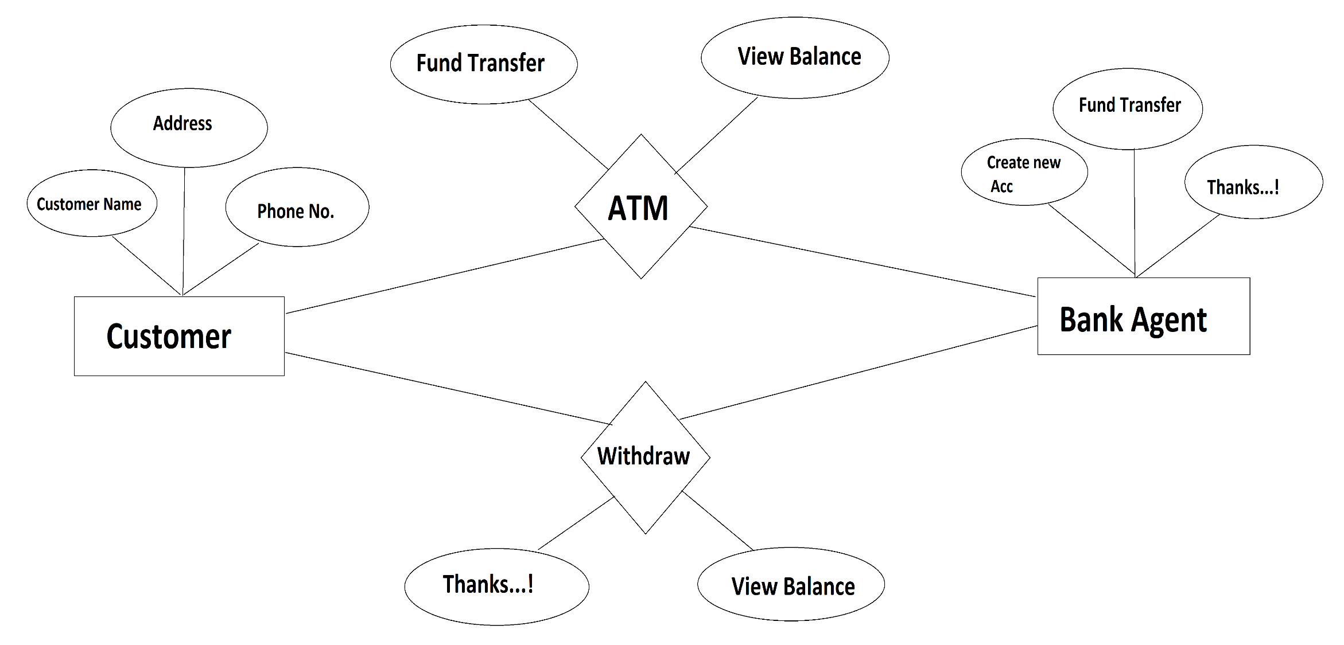
ER Diagram
Title text addition
Title text addition
Title text addition

Slide 8
CONCLUSIONS:
Bank management system is a virtualization of transactions in banking system.
The banking system are used manual working but when we used online banking system it is totally virtualization process which avoid manual process and converts it in automatic process .
If user can make a transaction in bank management system it is available in any were.
Bank management system is saving the time with accuracy than bank manual system.
Title text addition
Title text addition
Title text addition

Slide 9

THANK YOU

